Slide 1
FIREMISC
Flexible Intelligent Routing Engine
Mobility . Information . Social . Cloud

Slide 2
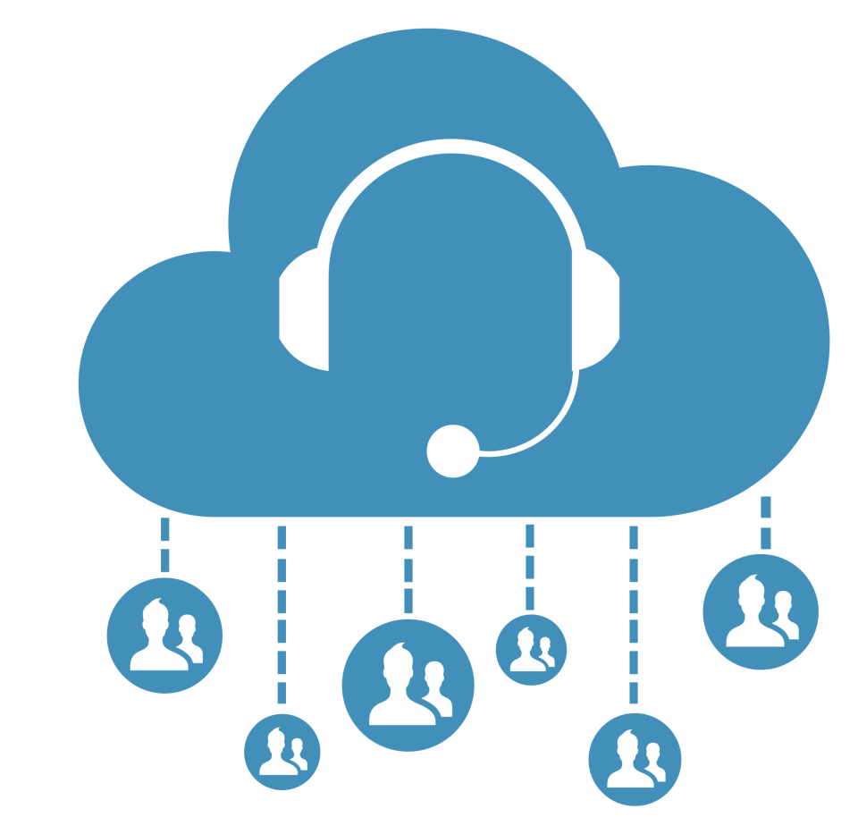
BORN ON CLOUD
Full digital experience platform born on cloud
Designed to run on minimum hardware
Designed to be very smart
5 minutes deployment time
Continues development

Slide 3
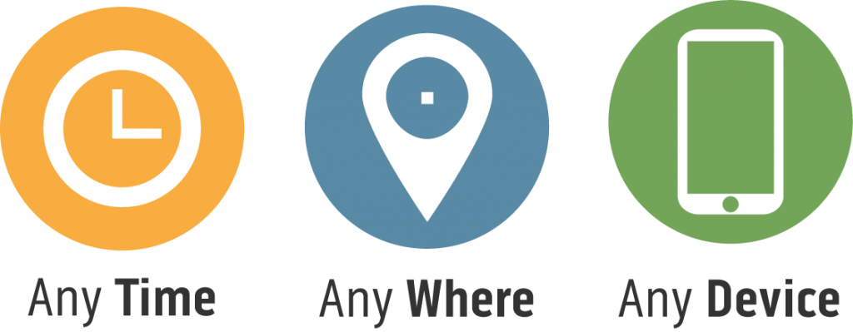
SMART CUSTOMER EXPERIENCE
TRACK DAY TO DAY

Slide 4
Problem
Define the problem

Slide 5
















Customer Social and Conversation Engagement Points
Social Networks
Messaging Platforms
Web/Mobile Conversation enabled Apps
Call Center
facebook
YouTube
Twitter
Instagram
LinkedIn
Messenger
WhatsApp
Twitter DM
Instagram DM
Snapchat
WeChat
?
The Problem
The Impact
Limiting our communications to only voice (over call centers), notifications and face-to-face (on branch).
Limited or No social presence.
A barrier to continuous customer experiences.
Missing huge opportunities in client acquisition, retention and revenue growth.
You are not where your customers are.
Not meeting Customer expectations.

Slide 6
Solution
Our promise

Slide 7










Customer Social and Conversation Engagement Points
Social Networks
Messaging Platforms
Web/Mobile Conversation enabled Apps
Call Center
facebook
YouTube
Twitter
Instagram
LinkedIn
Messenger
WhatsApp
Twitter DM
Instagram DM
Snapchat
WeChat
IO Channels
Posts
Chat
Notifications
Chat
Voice
Voice
Chat
Voice
Enterprise
FireMISC
FireRouter
VCA
(Virtual Customer Assistants)
VEA
(Virtual Enterprise Assistants)
BVA
(Business Visibility Application)
Analytics
Integration
chatbots
chatbots
Data store
Internal Systems
CRM
Search Engines
Data Stores
Cloud Services
Contact Center
BPM
Notes:
(Marketing, Customer Support,..etc)
Natural Language Understanding
Natural Language Generation

Slide 8




Customer Social and Conversation Engagement Points
Social Networks
Messaging Platforms
Web/Mobile Conversation enabled Apps
Call Center
facebook
YouTube
Twitter
Instagram
LinkedIn
Messenger
WhatsApp
Twitter DM
Instagram DM
Snapchat
WeChat
IO Channels
Posts
Chat
Notifications
Chat
Voice
Voice
Chat
Voice
Listen to social platforms feeds & IM messages.
Classify feeds / messages with multiple AI tags
Enterprise
FireMISC
FireRouter
VCA
(Virtual Customer Assistants)
VEA
(Virtual Enterprise Assistants)
BVA
(Business Visibility Application)
Integration
Analytics
Route feeds / messages to different destination including BVA and to your own Contact Centers using our of the box connectors to :
Route feeds / conversations to different VCA or VEA managing specific use cases, to support customer or to transact.
chatbots
chatbots
Data store
Internal Systems
CRM
Search Engines
Data Stores
Cloud Services
Contact Center
BPM

Slide 9
Capabilities
Solution Capabilities

Slide 10
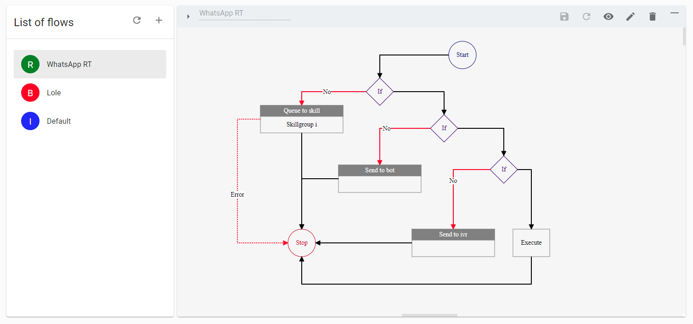
BOT
ROUTE
IVR

Slide 11
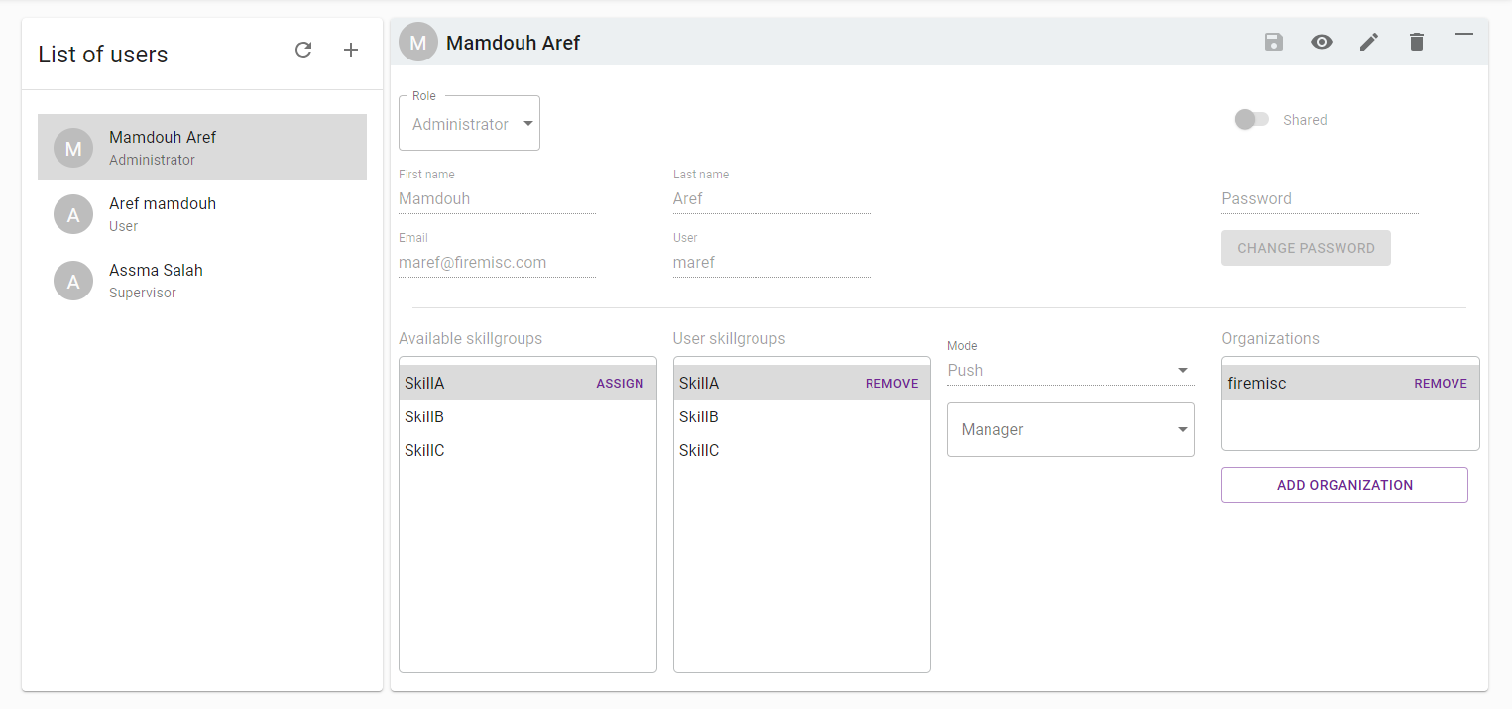
USER
AGENT
SUPERVISOR
LEADER
BUSINESS
ADMIN

Slide 12
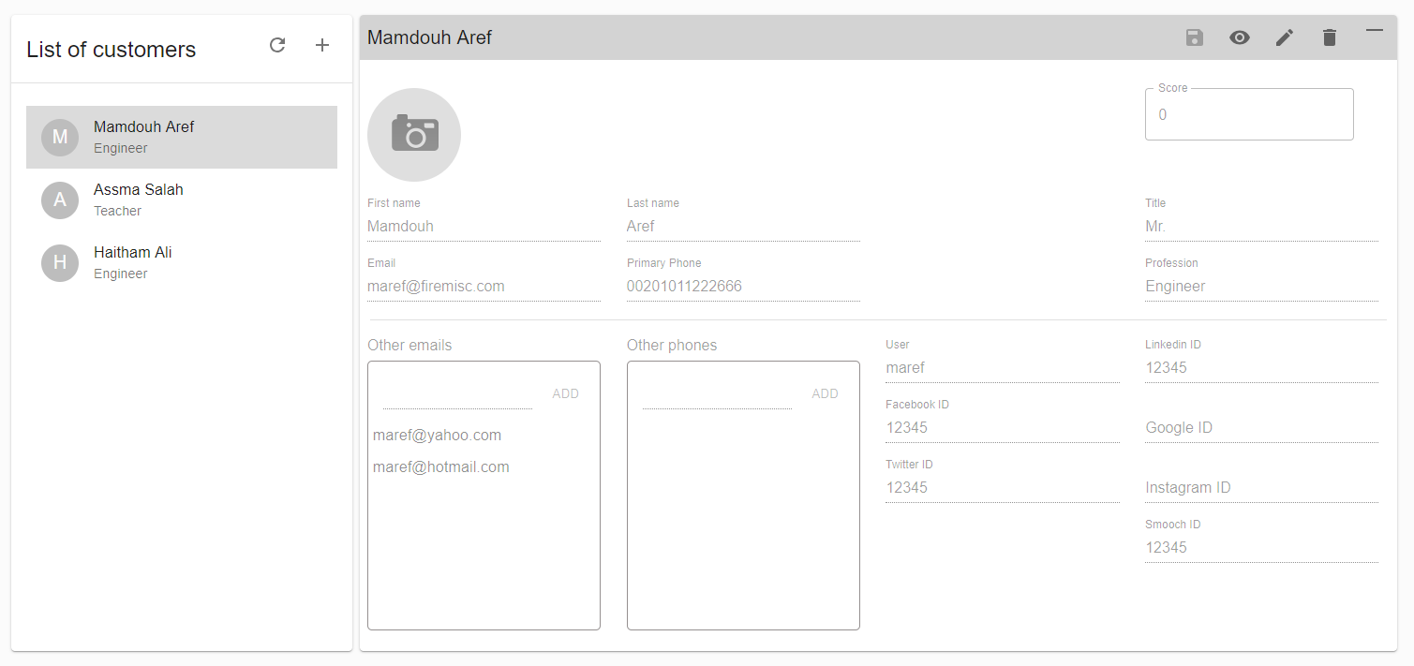
MANAGE
YOUR
CUSTOMERS

Slide 13
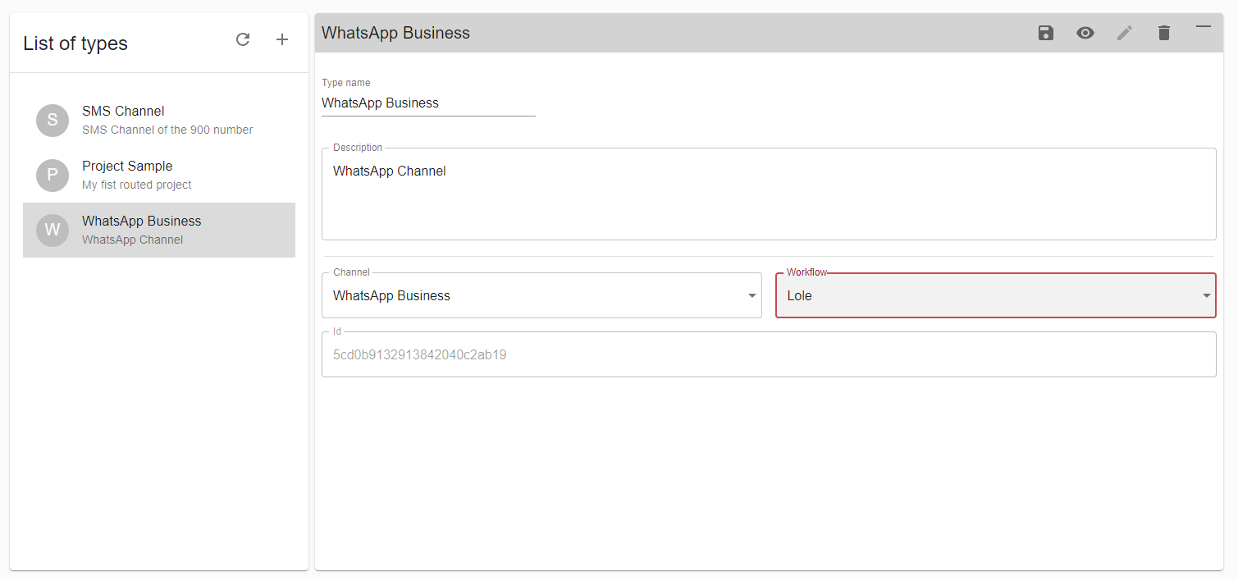
MANAGE
TYPES

Slide 14
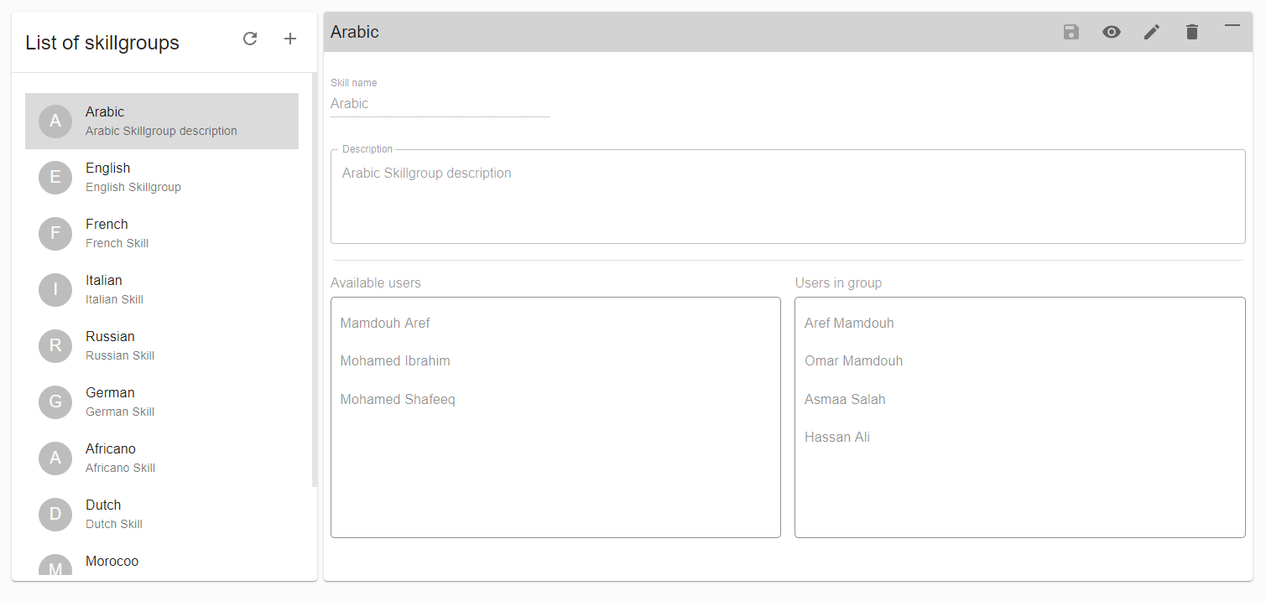
SKILLGROUPS

Slide 15
WhatsApp Business Channel
Example channel

Slide 16
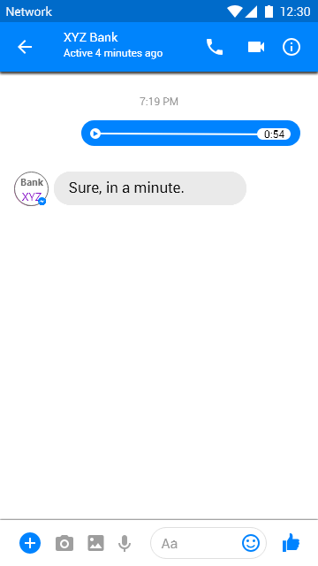

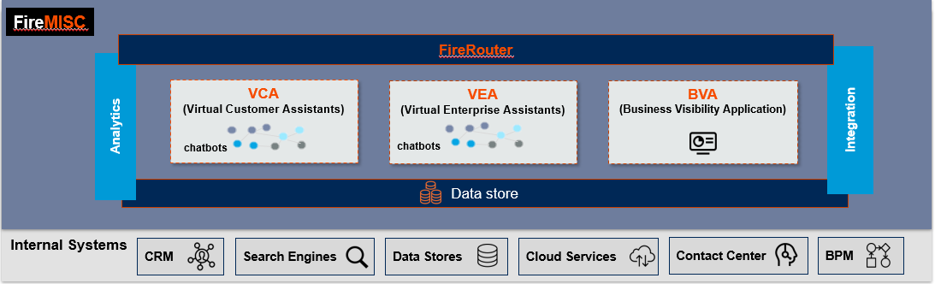
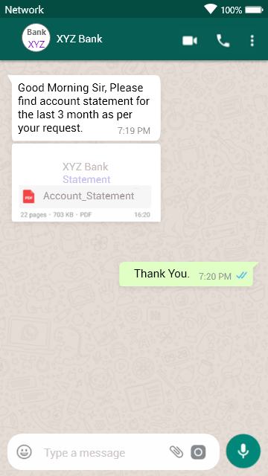

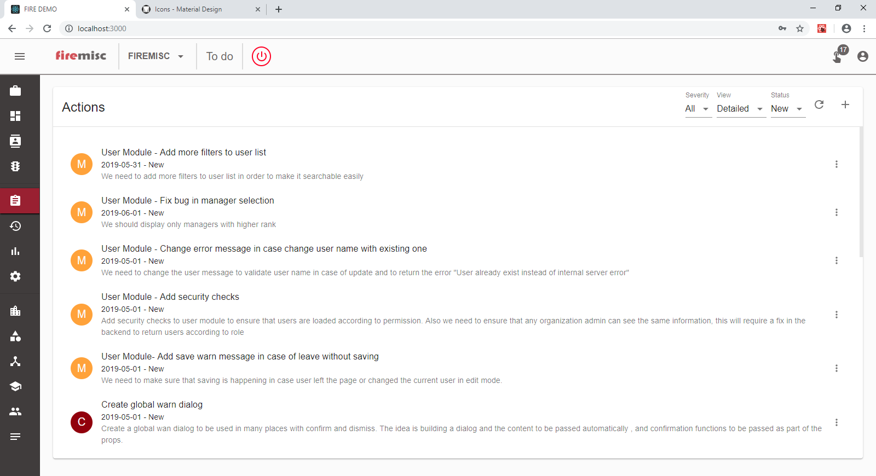

Agent Engagement: The custom is abroad, he wants an bill statement as pdf, the user uses facebook messenger to post a voice call message or make a voice call, which will be received by the call center agent/RM, and do the needed action.
Vodefone
1
2
3
8
4
7
5
9
10
6

Slide 17
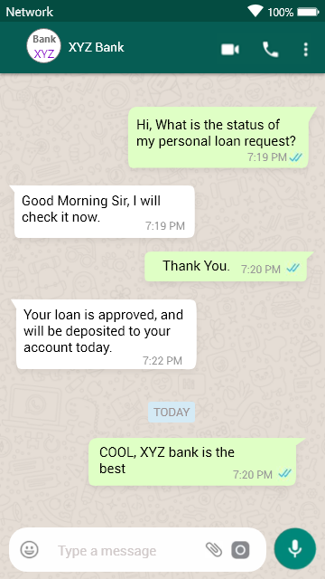

Agent Enagement: From Whatsapp for business, FireMisc receives a conversation from a Customer, inquiring about his Tenant cash loan request status, the agent receives and start the conversation from within his Cisco Contact Center WDE application screen, also is able to send/receive files
Tenant
2
3
1
8
10
9
4
7
5
6

Slide 18
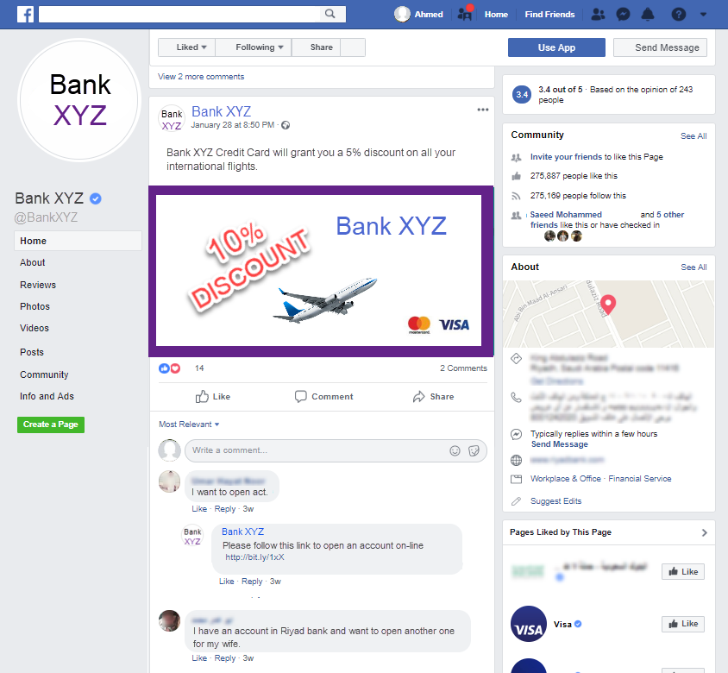

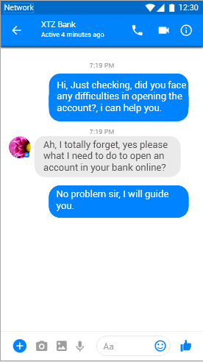
VCA Engagement: From Facebook messenger FireMisc receives a post from non customer interacting with Marketing Camping created earlier by Tenant, asking about a product, FireMisc router analysis the post, and classify it, create an opportunity and pass it into business process to process and create the opportunity properly, and in the end of the process send a notification to the customer for follow ups.
Tenant
1
2
3
6
7
6
4
10
5
8
9

Slide 19
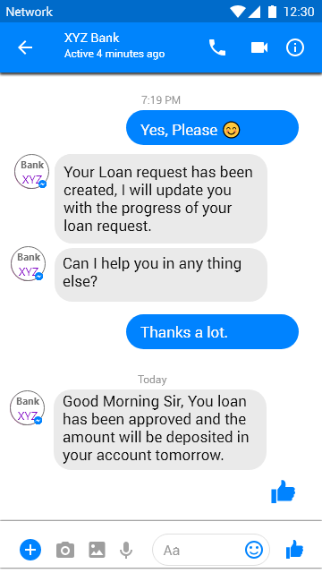
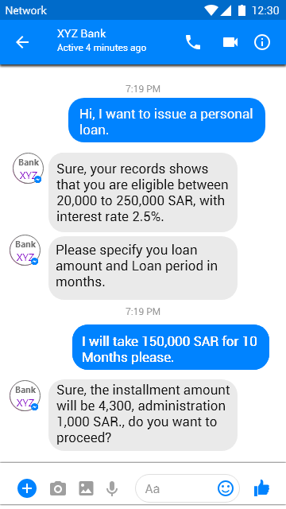
VCA Enagement: From Facebook messenger FireMisc receives a conversation from a Customer, to issue a Tenant cash loan, the conversation is directed to VPA Chabot, driving the conversation, integrating with the telecom systems, create the loan request, and notify the customer when loan is approved.
Tenant
3
6
1
2
4
7
6
9
8
5

Slide 20
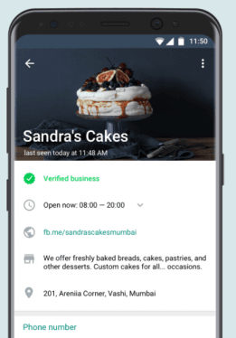
Business profile
Define you business profile.
A profile picture
Address of business
Description of business
Email for business contact
Business vertical/industry
Business website

Slide 21
Engagement Process
Listen
Message A
Message B
Message C
Qualify
Find Agent
Notify
Engage
Engage

Slide 22
Listen
WhatsApp
firemisc
WhatsApp Server
Webhook
Webhook is the main listener for each and every event happening.
Authentication
Notification
Message
Event

Slide 23
Qualify
User
Conversation
Route
Check User
Check if user is existing in our DB. In no user existing , then will add the user to the system. Attached User ID to the message
Check Conversation
Check if conversation is existing and Open. If true then attached the conversation ID to message. If false, open conversation and attached conversation ID and route request.

Slide 24
Engage
Initiate
Notify
Reply
Receive initial message
Agent receive initial message from IXN. And based on that request conversation details.
Agent to register in socket.io for notification.
Receive notification
This will happen for running sessions only where user can receive updates for running conversation.
Agent may auto refresh window to get the latest update.

Slide 25

Customer Service
Provide a different customer service through WhatsApp channel
Bot integrated service
Human based service

Slide 26
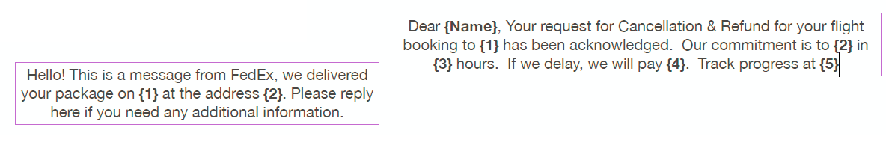
Template Response
Template messages cloud be used by Agent to standardize the response.
Template messages is the way of initiating a campaign with unknown contacts.

Slide 27
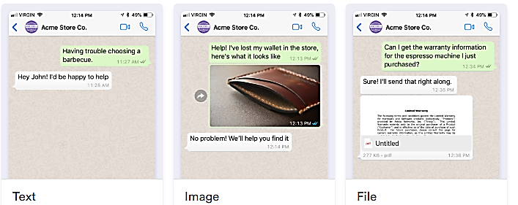
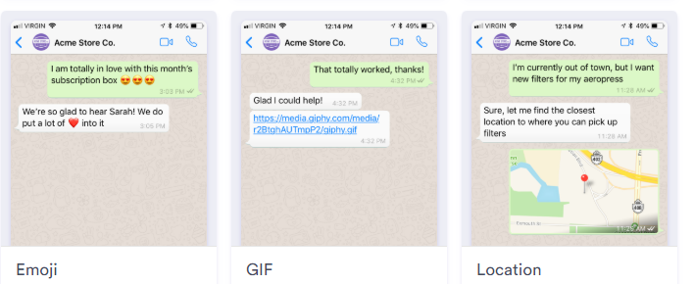
Typical WhatsApp Services

Slide 28
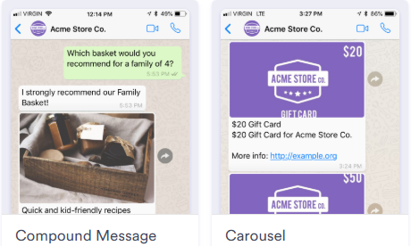
Message Structure

Slide 29

Scope
Expected number of unique users monthly
Forecasted number for monthly unique users.
Expected number of templated messages monthly.
Number of profiles with Data
More detailed use cases

Slide 30
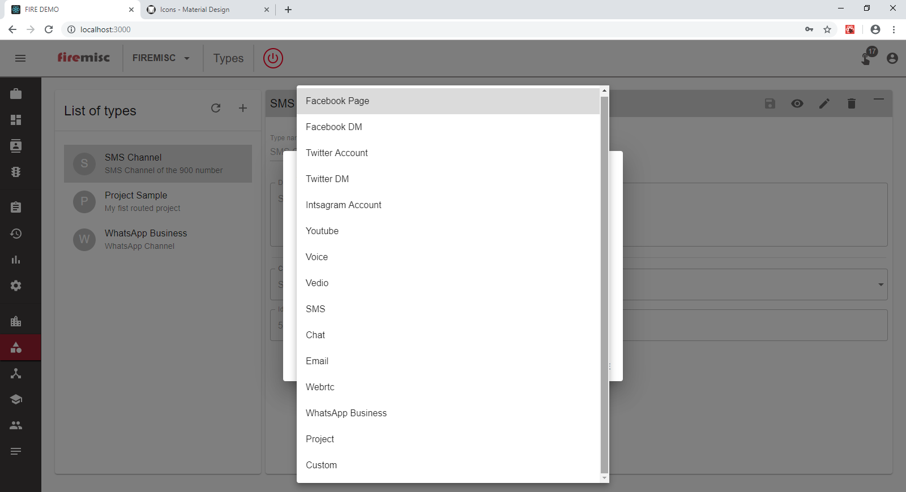
Channels

Slide 31
User Interface
firecontact

Slide 32
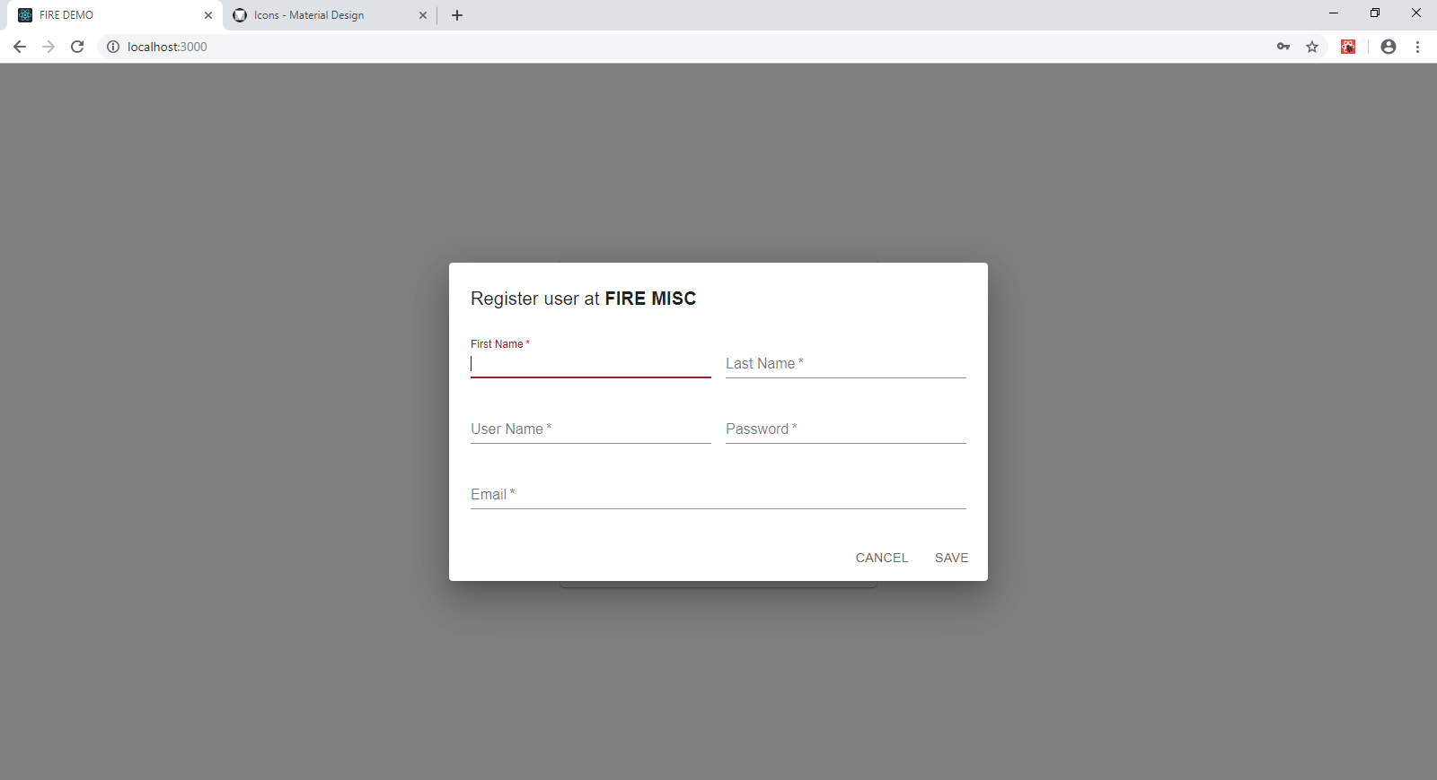
Register

Slide 33
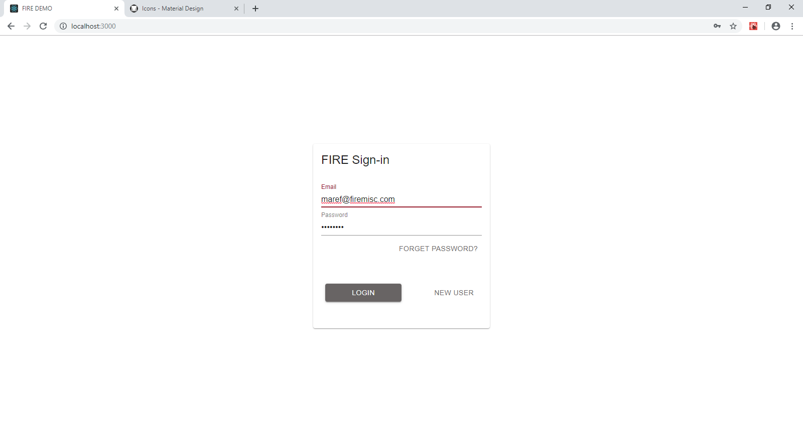
Login

Slide 34

To do

Slide 35
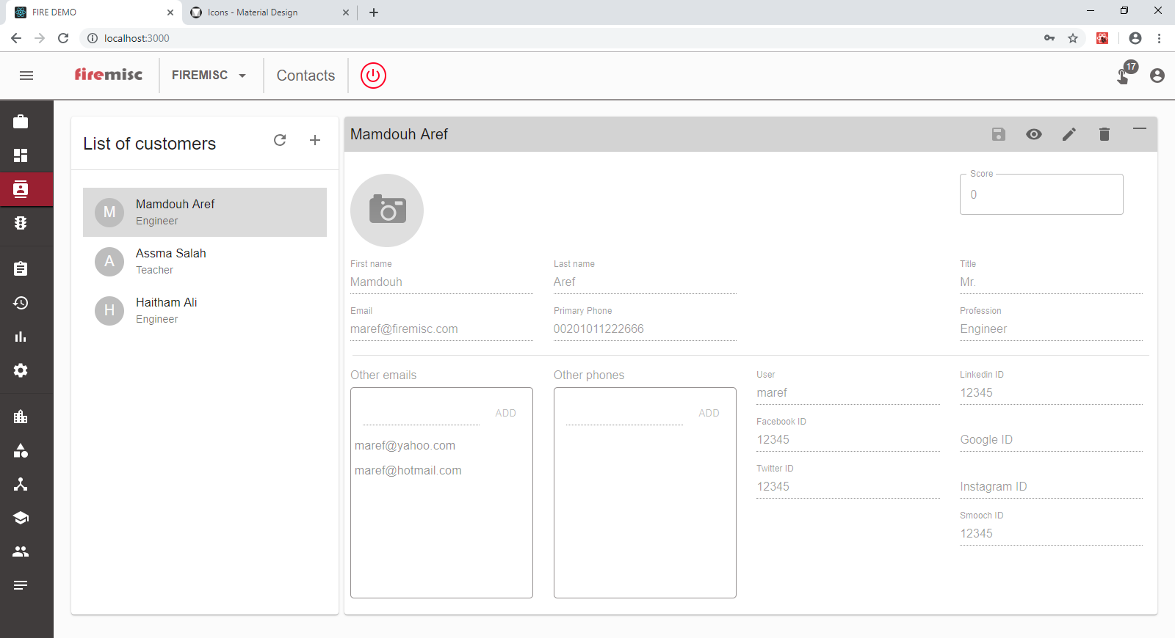
My customers

Slide 36
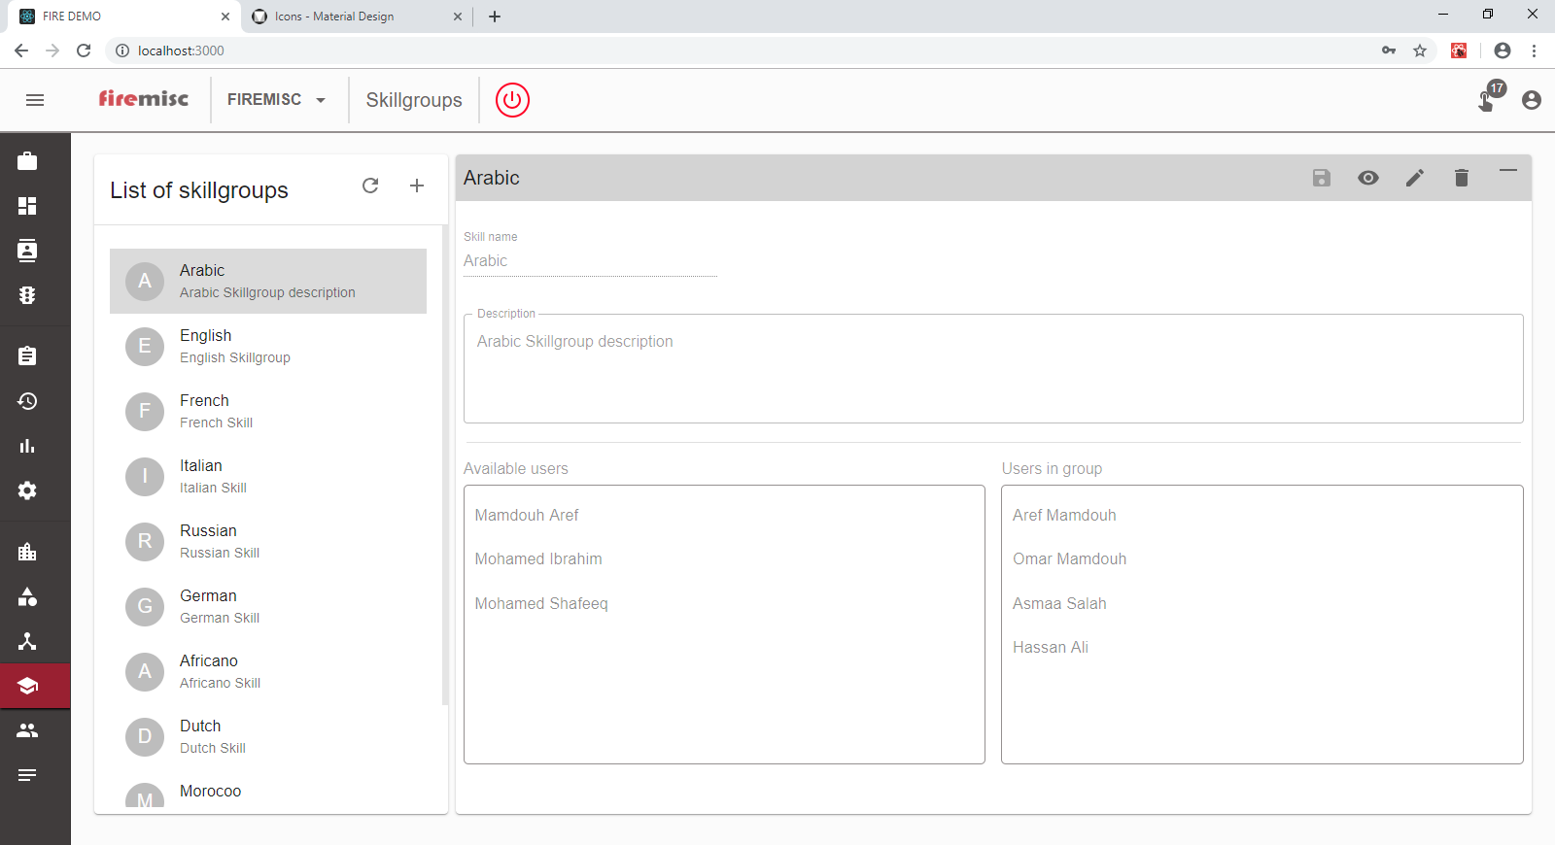
My skill groups

Slide 37
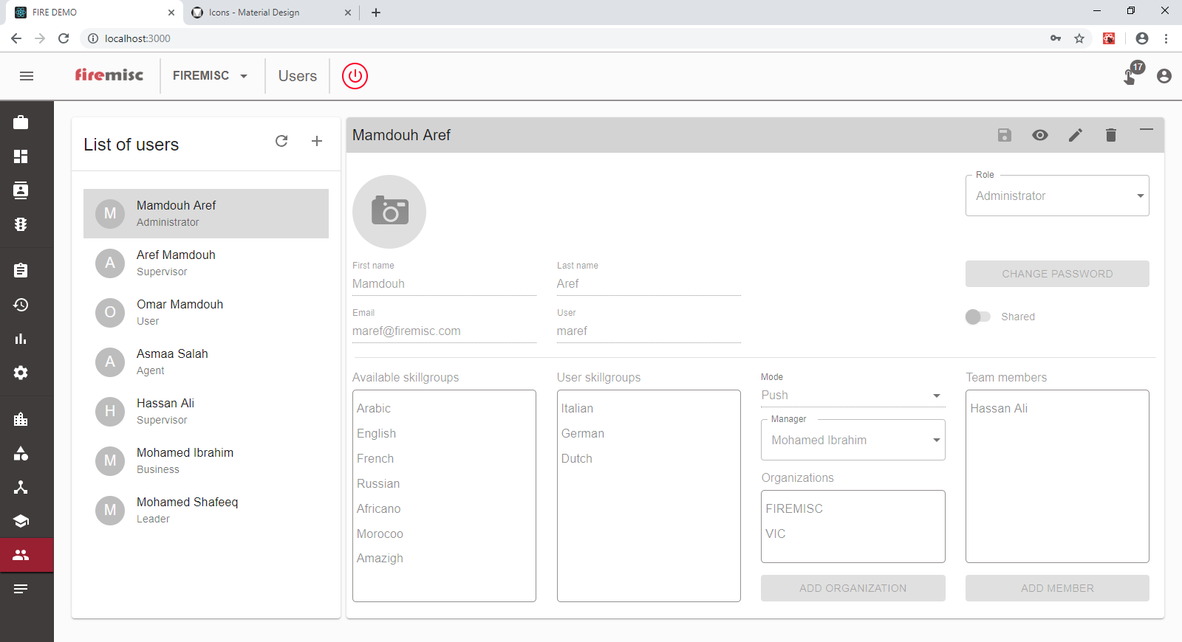
My users

Slide 38
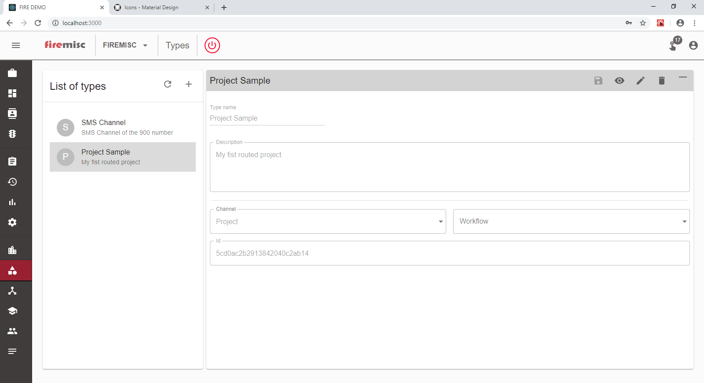
My types

Slide 39
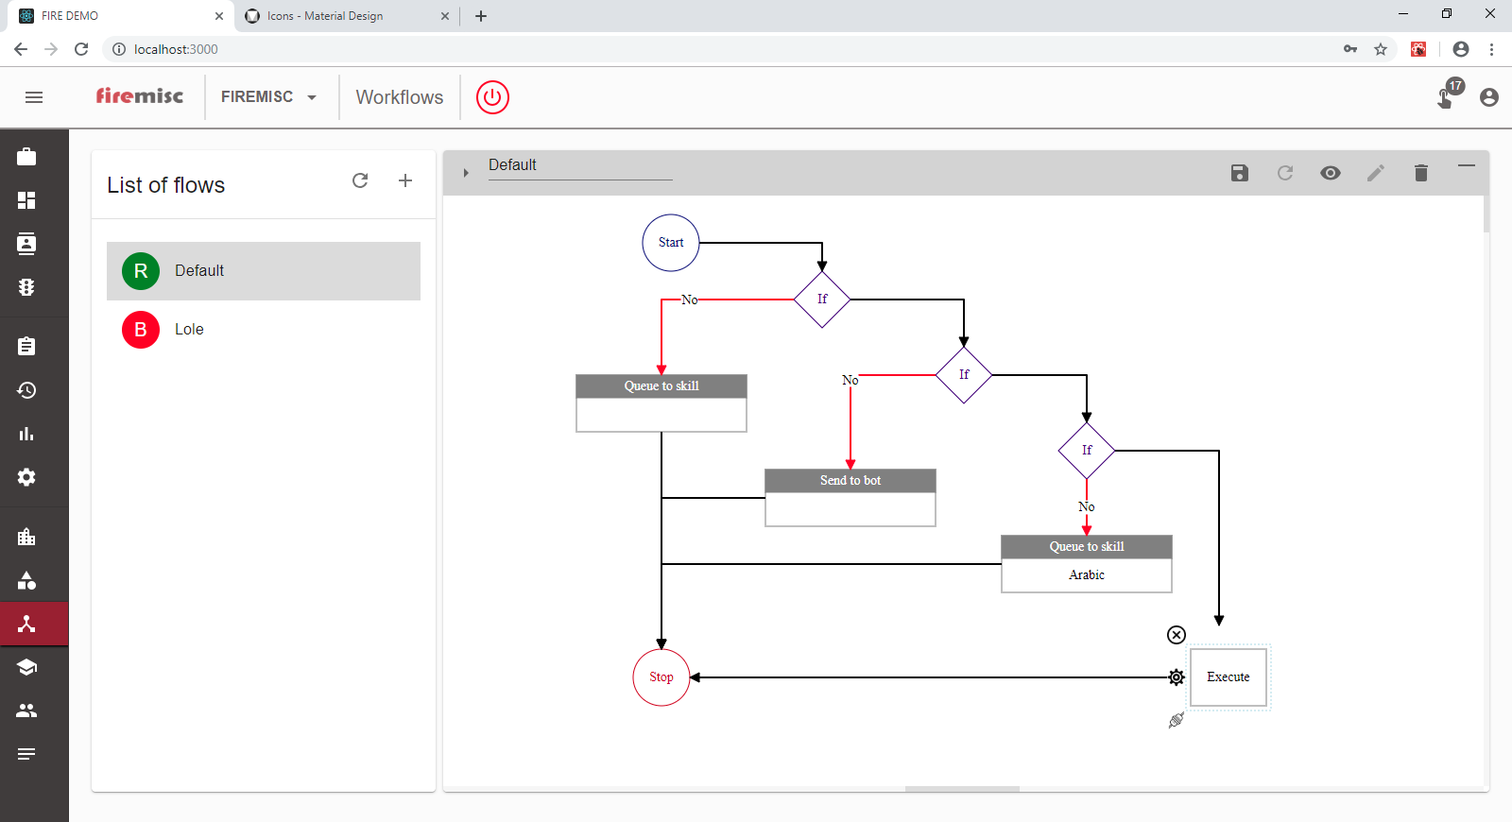
My workflows

Slide 40
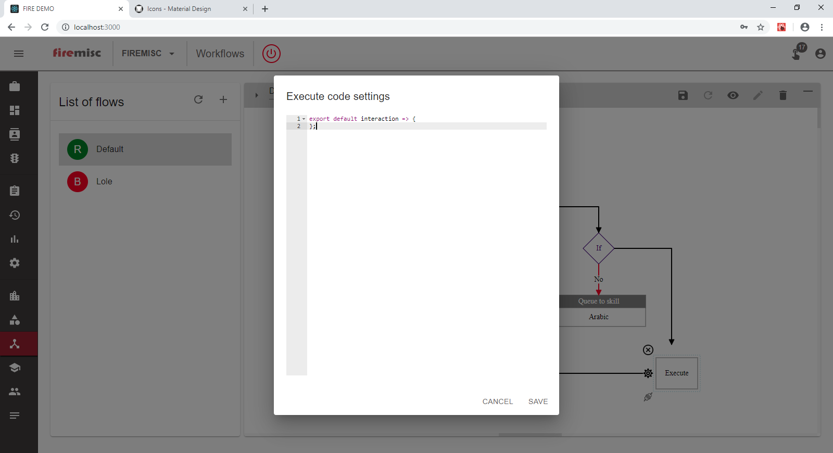
Advanced scripting

Slide 41
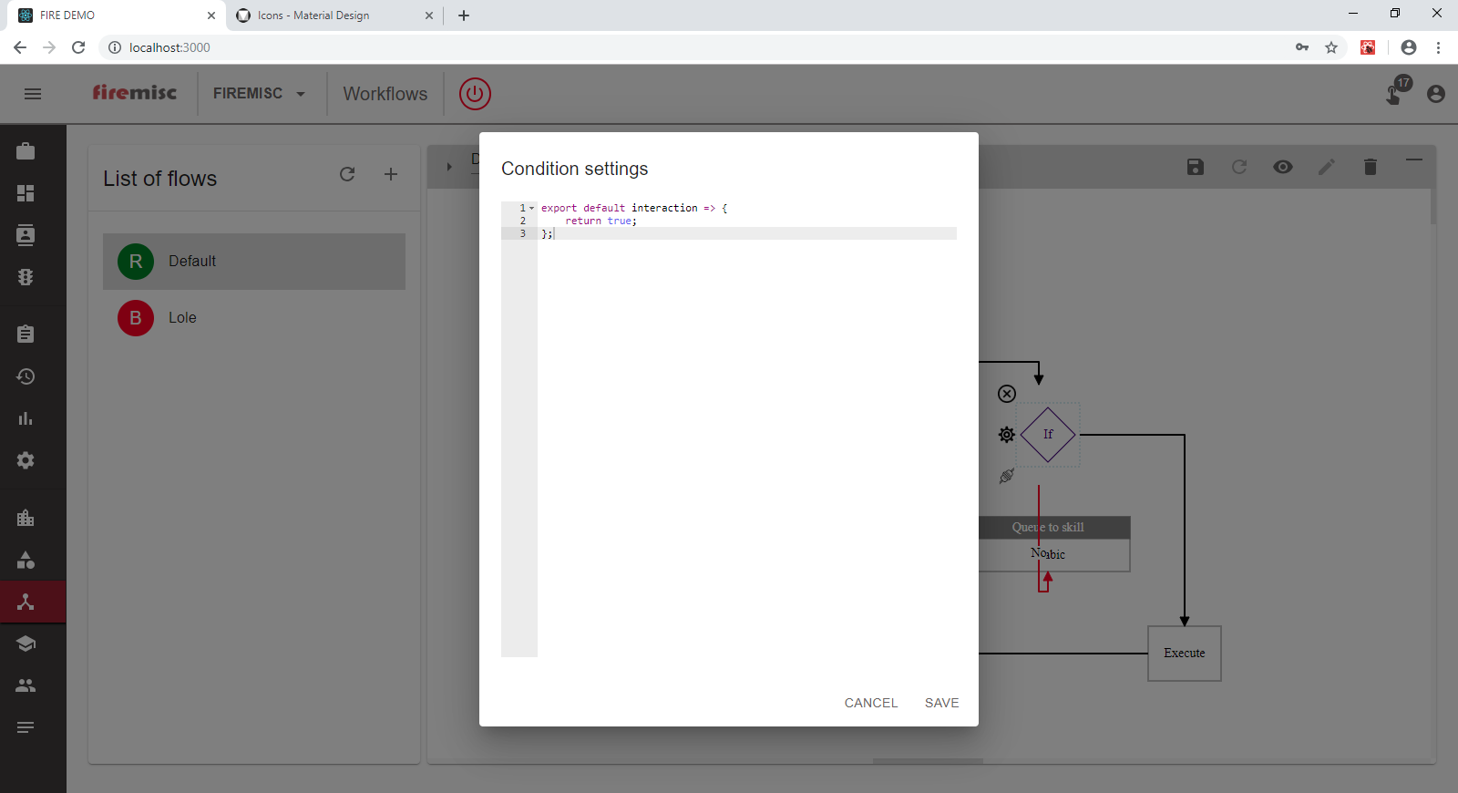
Advanced condition

Slide 42
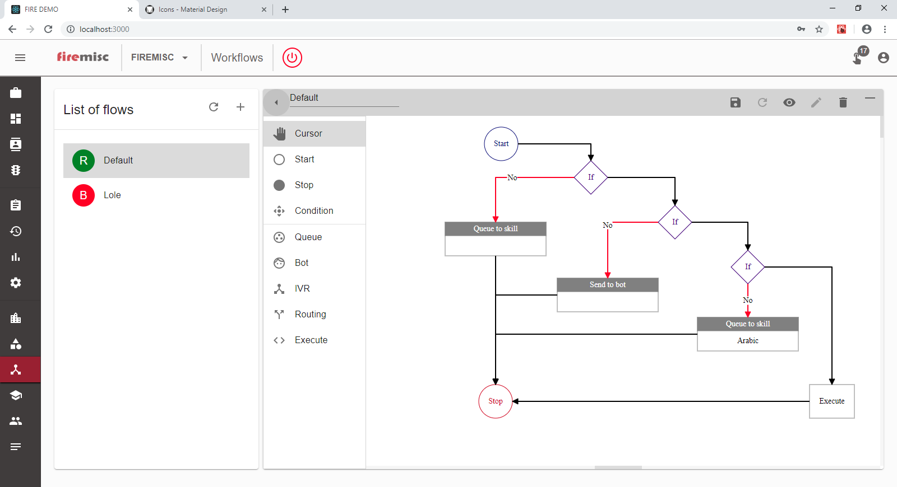
Toolbox

Slide 43
Deployment
On premises
Cloud
Require minimum 2 Servers for the core system of firemisc
App Server specifications
4 Cores
8 GB RAM
3 TB ( 1 TB per year on average)
Storage Server specifications
4 Cores
16 GB RM
500 GB
Monthly subscription per seat
Follow our rollout at
www.firemisc.com

Slide 44
Request more details
Contact us : www.firemisc.com
maref@firemisc.com

